Slide 1


Buildable DIGITAL HEALTH BLUEPRINT
Developing “construction” documents and an
investment and implementation roadmap for the national HIE
HIE Specifications
[Date].

Slide 2

WORKSHOP PLAN…
Leverage each successive workshop to progress the development of the blueprint:
Use cases (choosing our initial care pathways)
Digital health specifications (Integration Profiles)
“Lego blocks” (conformant eHealth solutions)
Implementation science (making it “go”)
Each session builds on the one before it…

Slide 3

Workshop-2 Digital Health Specifications

Slide 4
WORKSHOP-2 AGENDA
Brief recap and review
The “metaphor” for a Health Information Exchange (HIE)
OpenHIE: an architected approach to health data sharing
Transaction processing model
Person-centric data model
An infrastructure model for OpenHIE-on-FHIR
Computable Care Guidelines (CCGs): an architected approach to broad adoption of evidence-based care
Leveraging the repeatable 1-2-3-4 pattern to operationalize best-practices and improve health
Leveraging “atomic” data to improve our ability to analyse and manage
Next steps

Slide 5

What could care look like once we have a national health information exchange (HIE)?

Slide 6
We’re going to follow a “health story”.
Here are our story’s characters:
A Patient (Amar);
Care Providers (Amar’s family doctor, the private sector local Pharmacist, a lab technician);
A wide range of point of service (POS) digital health solutions (EMR, pharmacy system, diagnostic imaging system);
The national health information exchange (HIE);
An MOH-operated personal health record (PHR) portal that citizens can use to access and track their health information.

Slide 7

Amar is 36 years old. He lives with his wife and two small children in an apartment in the capital city.
Amar is a heavy smoker and has been since he was a teenager.
He is being treated for chronic pulmonary disease.
Last month, Amar purchased his first smartphone.
This is Amar.

Slide 8


HIE
EMR
PHR
Primary Care Clinic

Slide 9

HIE
Amar attends his regular checkup with his family doctor. He presents his health ID card.
EMR
PHR
Primary Care Clinic

Slide 10
HIE
Amar’s doctor uses her cloud-hosted electronic medical records (EMR) solution to retrieve Amar’s demographic record from the national HIE. She updates the record with Amar’s new phone #.
EMR
PHR
ID#
Amar’s Demographic Record
Primary Care Clinic

Slide 11
HIE
She retrieves Amar’s health summary record from the HIE.
EMR
PHR
ID#
Amar’s Health Summary
Primary Care Clinic

Slide 12
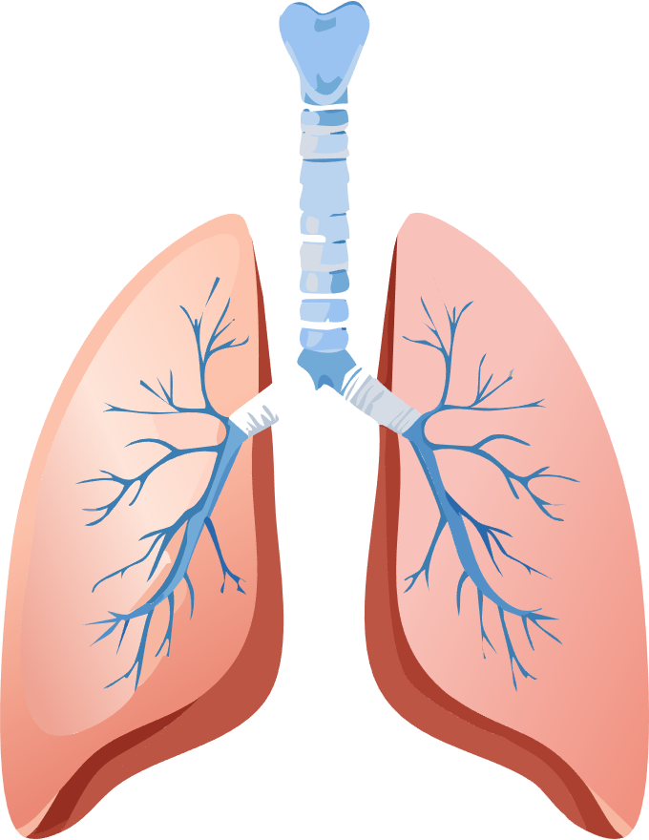

HIE
Based on the care guidelines for Amar’s chronic pulmonary disease, the doctor records Amar’s vital signs. His lung capacity reading is concerning.
Care
Guidelines
EMR
PHR
Observations:
-BP (slightly elevated)
-Weight (slightly increased)
-Spirometry (worrying!)
Primary Care Clinic

Slide 13

HIE
Following the guidelines, Amar’s doctor changes the prescription for his inhaler. She also orders a Lung Cancer Screening Test for Amar. As has been the case in the past, Amar does not agree to try to stop smoking.
Care
Guidelines
EMR
PHR
Orders:
-Inhaler (changed prescription)
-Lung Cancer Screening Test
-Smoking Cessation Programme (not ordered)
Primary Care Clinic

Slide 14
HIE
Amar’s health summary is updated with the observations, his ePrescription, and his diagnostic test order. The updated summary is saved to the HIE.
EMR
PHR
ID#
Amar’s [Updated] Health Summary
Primary Care Clinic

Slide 15


HIE
Amar accesses the PHR portal using his new phone. In his health summary, he sees his ePrescription and his diagnostic test order.
EMR
PHR

Slide 16


HIE
EMR
PHR
Private-sector Pharmacy

Slide 17

HIE
Amar goes to the private sector pharmacy near his apartment and presents his health ID card.
EMR
PHR
Private-sector Pharmacy

Slide 18
HIE
The Pharmacist enters Amar’s ID into his commercial software solution. From the HIE, the Pharmacist retrieves Amar’s demographic record (including the updated phone #)…
EMR
PHR
ID#
Amar’s Demographic Record
Private-sector Pharmacy

Slide 19
HIE
…and the health summary, including Amar’s ePrescription
for a new inhaler.
EMR
PHR
ID#
Amar’s Health Summary
Private-sector Pharmacy

Slide 20


HIE
The Pharmacist scans the product barcode (the Global Trade ID Number, GTIN) and dispenses the replacement inhaler.
EMR
PHR
Inhaler GTIN
Private-sector Pharmacy

Slide 21
HIE
Based on the GTIN, the Pharmacist prints the inhaler’s product information sheet and reviews it with Amar.
EMR
PHR
Private-sector Pharmacy

Slide 22
HIE
Amar’s health summary is updated with the dispensation information. The summary is posted to the HIE.
EMR
PHR
ID#
Amar’s [Updated] Health Summary
Private-sector Pharmacy

Slide 23

HIE
On his PHR summary, Amar
sees the details of his new inhaler, including the product name, manufacturer, lot #, and
expiry date.
EMR
PHR

Slide 24


HIE
EMR
PHR
Diagnostic Imaging Lab

Slide 25
HIE
Amar attends his appointment for the Lung Cancer Screening Test and presents his health ID card.
EMR
PHR
Diagnostic Imaging Lab

Slide 26
HIE
The lab technician uses her Diagnostic Imaging software solution to retrieve Amar’s demographic record from the HIE
(including his updated phone #)…
EMR
PHR
Amar’s Demographic Record
ID#
Diagnostic Imaging Lab

Slide 27
HIE
…as well as his health summary, including the order for a
Lung Cancer Screening Test.
EMR
PHR
Amar’s Health Summary
ID#
Diagnostic Imaging Lab

Slide 28
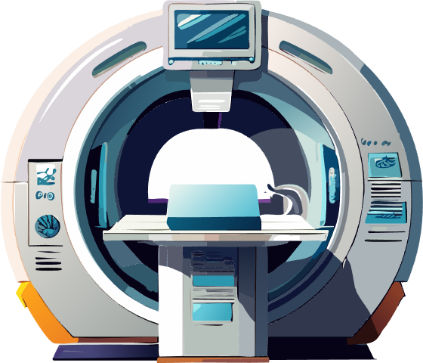

HIE
The lab technician conducts
a low-dose CT scan on Amar.
EMR
PHR
Diagnostic Imaging Lab

Slide 29

HIE
The lab technician updates Amar’s health summary to note the test results are “in progress”.
The summary is posted to the HIE.
She tells Amar he will be
notified when the test results
are complete.
EMR
PHR
Amar’s [Updated] Health Summary
ID#
Diagnostic Imaging Lab

Slide 30

HIE
Since the test, Amar has started to make changes in his eating, exercise and smoking habits.
He has started tracking his weight on the PHR portal.
EMR
PHR

Slide 31
HIE
Amar’s scans have been interpreted and his test results have been saved to the HIE.
On his PHR account, Amar receives a notice that his test results are ready to be reviewed with his family doctor.
EMR
PHR

Slide 32

HIE
Amar’s scans have been interpreted and his test results have been saved to the HIE.
On his PHR account, Amar receives a notice that his test results are ready to be reviewed with his family doctor.
EMR
PHR

Slide 33
HIE
EMR
PHR
Primary Care Clinic

Slide 34
HIE
Amar attends an appointment
with his family doctor to review
his test results. He presents his health ID card.
EMR
PHR
Primary Care Clinic

Slide 35
HIE
Using her cloud-hosted EMR, Amar’s family doctor retrieves
his demographic record from
the HIE…
EMR
PHR
ID#
Amar’s Demographic Record
Primary Care Clinic

Slide 36
HIE
…as well as his health summary, which includes details of his dispensed inhaler and of his
low-dose CT scan.
EMR
PHR
ID#
Amar’s Health Summary
Primary Care Clinic

Slide 37

HIE
Following the guidelines, the doctor records Amar’s vital signs and congratulates him on the improvements in the readings.
Care
Guidelines
EMR
PHR
Observations:
-BP (normal)
-Weight (slightly decreased)
-Spirometry (improved)
Primary Care Clinic

Slide 38
HIE
She reviews the test results with Amar. Based on his Lung-RADS® score, he is scheduled for a
six-month follow-up.
Care
Guidelines
EMR
PHR
Orders:
-Lung Cancer Screening Test (6 months)
-Smoking Cessation Programme
Primary Care Clinic

Slide 39
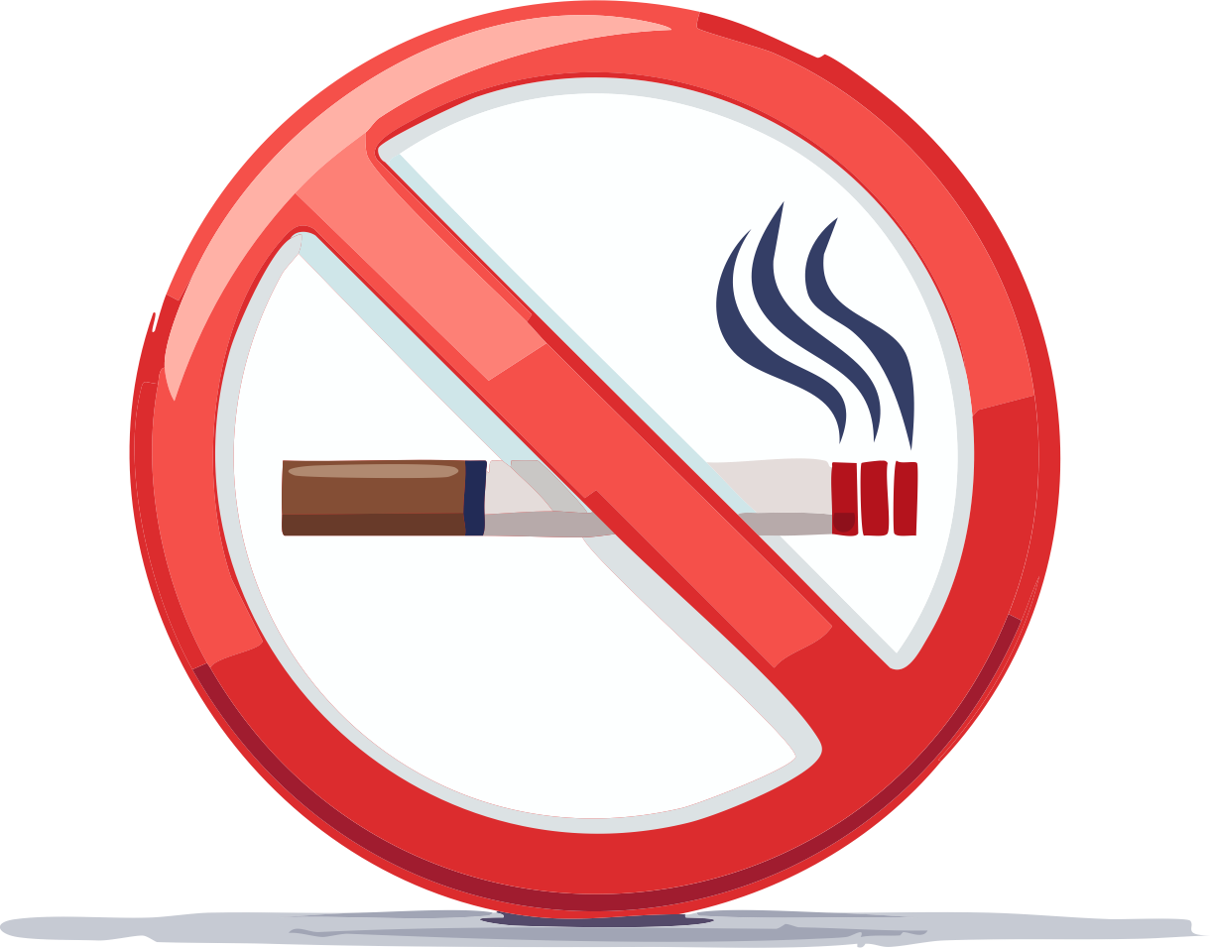
HIE
This is a wake-up call for Amar. Thinking of his family and his future, Amar finally agrees to
try to quit smoking. His doctor encourages him and enrols him
in a stop-smoking programme
run by the community clinic near his home.
Care
Guidelines
EMR
PHR
Orders:
-Lung Cancer Screening Test (6 months)
-Smoking Cessation Programme
Primary Care Clinic

Slide 40
HIE
Amar’s health summary is updated with the observations and the two new orders. The summary is posted to the HIE.
EMR
PHR
ID#
Amar’s [Updated] Health Summary
Primary Care Clinic

Slide 41
HIE
On Amar’s phone, he sees the lung cancer screening results, the follow-up appointment, and his enrolment in the stop-smoking programme. For the sake of his family, he is committed to making the changes he needs to make.
EMR
PHR

Slide 42
HIE
Primary Care Clinic
EMR
PHR
Amar’s Record
Private-sector Pharmacy
Diagnostic Imaging Lab
The HIE connects the disparate cloud-hosted and locally-installed digital health solutions together so they can operate as a “system” on behalf of Amar’s care.

Slide 43


HIE
EMR
PHR
Ministry of Health
The MOH can leverage analyses of the system-wide data in the HIE to inform better decision-making and improve health system management for the benefit of Amar… and everyone.

Slide 44

KEY TAKEAWAY POINTS
Care providers, across both the public and private sectors, use a wide range of disparate point of service (POS) digital health solutions.
Some POS solutions are cloud-hosted, others are local.
To support care continuity for Amar, all POS solutions leverage the health information exchange (HIE) to keep Amar’s shared health data current and correct.
Using the MOH’s PHR portal, Amar can access his health summary record. He can also enter personal information that helps him better manage his health journey.
Analyses of the detailed data in the HIE can inform MOH decision-making and improve health system management.

Slide 45

Questions and Answers?

Slide 46

What is OpenHIE… and how does it help us?

Slide 47


Enterprise architecture has been described as being analogous to urban planning. The idea of an urban plan is that investments in shared infrastructure and shared services are leveraged in order to allow a city to successfully “scale”.

Slide 48

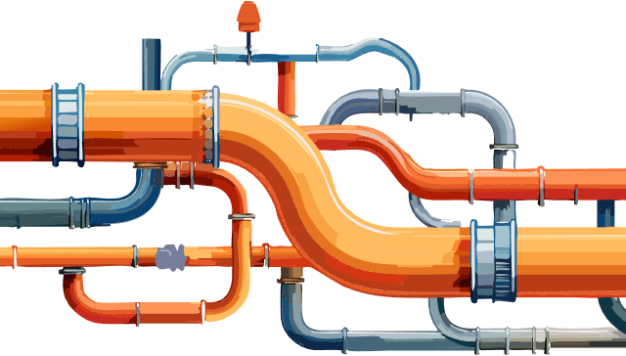
Standards-based connectors are used by builders so that their buildings can plug into the shared services. The growth of the city is governed by the urban plan.

Slide 49
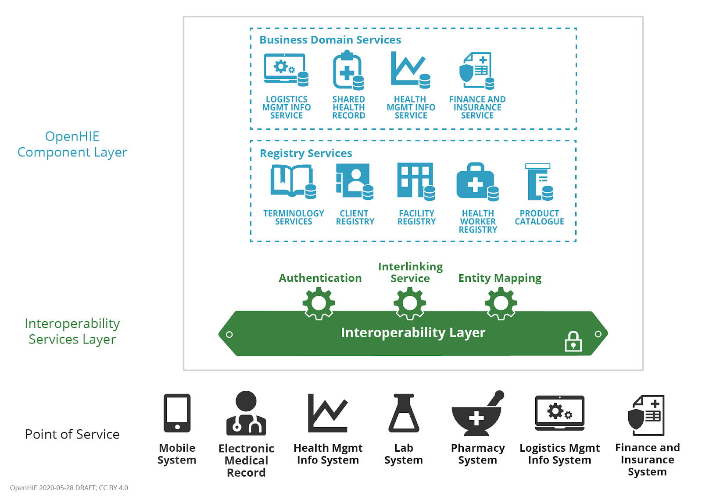

Over 60 LMICs have adopted OpenHIE as the basis of their health enterprise architecture. OpenHIE defines a set of infrastructure and service specifications that, together, operationalizes a health data sharing network.

Slide 50
For the purposes of our Buildable Blueprint specification, we will include
as in-scope the OpenHIE infrastructure and workflows directly related to healthcare delivery.

Slide 51

MHD
mADX
The OpenHIE community has identified IHE’s MHDS (mobile Health Data Sharing) portfolio of specifications as the transaction processing model for OpenHIE-on-FHIR.
SVCM
mCSD
PMIR
IUA
ATNA/CT
IHE MHDS
Transactional behaviour

Slide 52
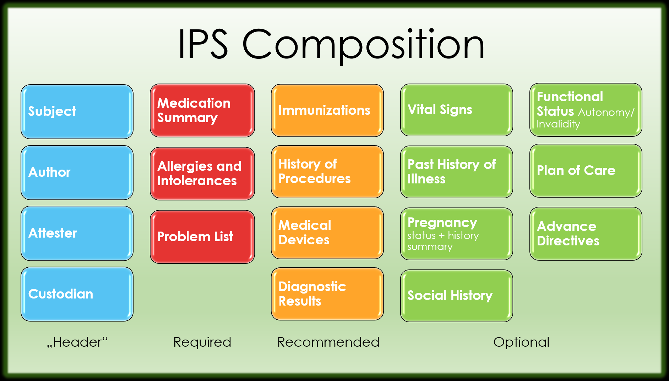






The OpenHIE community, the AeHIN network, and the GDHP have all selected the International Patient Summary (IPS) as their person-centric health data content model.
*
FHIR IPS IG
Content Model

Slide 53







Core transaction set
Add or update a patient demographic record
Query for a patient demographic record
Add or update person-centric health data
Query for person-centric health data
Query for registry content
Refresh registries from underlying (federated) directories
Submit aggregate data report
Lookup/validate codes and translate between codes
Retrieve and $apply computable care guideline (CCG)
Common functions related to security, privacy and auditing…
[ITI-93]
[ITI-78]
CR
[ITI-65]
[PCC-IPS]
[ITI-68]
[PCC-IPS]
SHR
[ITI-90]
[ITI-91]
ILR-HWR
ILR-FR
[QRPH-53]
[QRPH-58]
[ITI-98:ITI-101]
HMIS
[PCC-64]
[PCC-70]
ILR/TS
CCG Engine
ATNA
NOTE: at present – OpenHIE-on-FHIR is based on FHIR® v4.

Slide 54
KEY TAKEAWAY POINTS
Health enterprise architecture (HEA) is like urban planning; we want to leverage shared infrastructure and shared services to deliver shared benefits at scale.
OpenHIE is a widely-adopted HEA that can be operationalized using the modern HL7 FHIR® standard.
A health data sharing infrastructure based on OpenHIE-on-FHIR can be assembled from a small set of standards-based, conformance-testable “Lego® Blocks”.

Slide 55

Questions and Answers?

Slide 56
INTERACTION 2.1
<paste Form link here>
What architectural elements of the OpenHIE data sharing infrastructure do we have already?
What is the degree of adoption of the HL7 FHIR standard within our deployed digital solutions?
What norms and standards are we using, now, related to person-centric, “coded”, health data?

Slide 57

COFFEE BREAK!
Notes:
Use this slide as a “break slide”

Slide 58

How should we deploy a national infrastructure based on OpenHIE-on-FHIR?

Slide 59
DESIGN PRINCIPLES
A hosted HIE deployment model is recommended.
An online transaction processing (OLTP) FHIR Server will be optimized for performance.
In order to defend its performance, batch, maintenance, or analytics-focused processing will operate separately from the OLTP FHIR Server.
It is expected an enterprise service bus will orchestrate transactions and will centralize security, privacy, and auditing.
POS solutions that operate in an occasionally offline mode will be expected to leverage local caching and have a synchronization capability once re-connected.

Slide 60
Core transaction set
Add or update a patient demographic record
Query for a patient demographic record
Add or update person-centric health data
Query for person-centric health data
Query for registry content
Refresh registries from underlying (federated) directories
Submit aggregate data report
Lookup/validate codes and translate between codes
Retrieve and $apply computable care guideline (CCG)
Common functions related to security, privacy and auditing…
[ITI-93]
[ITI-78]
CR
[ITI-65]
[PCC-IPS]
[ITI-68]
[PCC-IPS]
SHR
[ITI-90]
[ITI-91]
ILR-HWR
ILR-FR
[QRPH-53]
[QRPH-58]
[ITI-98:ITI-101]
HMIS
[PCC-64]
[PCC-70]
ILR/TS
CCG Engine
ATNA

Slide 61

HWD
FD
ORG
Interoperability Layer
(16)
(16)
(16)
(16)
OLTP FHIR Server
(2)
TS*
(5)
ILR/TS
ILR-HWR
ILR-FR
ILR-ORG
SHR
HMIS
CR*
CR
(7)
(10)
(11,12,13,14)
(10)
(10)
(10)
(8)
(9)
(9*)
(15)
(7)
ATNA
(8)
(9)
(10)
(11,12,13,14)
(15)
(1)
(3)
(4)
(Maintenance/batch transactions)
(Real-time runtime transactions)
CR*
POS
(6)
POS
Solution
(9)
CCG
Engine
(17)

Slide 62


“Feeder” Systems
HWD
FD
ORG
Interoperability Layer
(16)
(16)
(16)
(16)
“Companion” Systems
OLTP FHIR Server
(2)
TS*
(5)
ILR/TS
ILR-HWR
ILR-FR
SHR
HMIS
Finance
CR
ILR-ORG
CR*
(7)
(10)
(11,12,13,14)
(10)
(10)
(10)
(8)
(9)
(9*)
(15)
SCM
(7)
ATNA
(8)
(9)
(10)
(11,12,13,14)
(15)
(1)
(3)
(4)
CR*
POS
(6)
POS
Solution
(9)
CCG
Engine
Real-time Systems
(17)

Slide 63

HWD
FD
ORG
Interoperability Layer
(16)
(16)
(16)
(16)
OLTP FHIR Server
Terminology Publishing. A terminology server (TS*) will be employed to curate and cross reference the national lists of normative codes. As part of a regular refresh process, the MOH will publish updated code lists and make these available so that digital health POS solutions can update their code lists. This is illustrated by transaction (1). As shown by transaction (2), these published terminologies will also update the runtime code lists maintained in the OLTP-optimized FHIR Server. NOTE: it is common for such publishing processes to employ Excel and/or PDF files as the means of distributing code lists. Each POS solution will be required to be able to ingest the published format. The interactions with the TS* may be managed via the Interoperability Layer.
(2)
TS*
(5)
ILR/TS
ILR-HWR
ILR-FR
ILR-ORG
SHR
HMIS
CR*
CR
(7)
(10)
(11,12,13,14)
(10)
(10)
(10)
(8)
(9)
(9*)
(15)
(7)
ATNA
(8)
(9)
(10)
(11,12,13,14)
(15)
(1)
(3)
(4)
CR*
POS
(6)
POS
Solution
(9)
CCG
Engine
(17)

Slide 64
HWD
FD
Manage Client Registry Records. It is expected that there may be a ceremony associated with managing Client Registry records. A barcoded unique ID card may be issued, as an example, that will associate the client’s demographic information with their unique health identifier. As part of maintenance, duplicate client records that have been created in error will need to be de-duplicated (and the underlying IDs merged). These processes may be operationalized by every POS, or there may be a specialized solution (CR* POS) that is dedicated to efficiently and correctly executing client record ID-management, including the “new client ID” ceremony. The CR* POS will need to support both adding and updating client demographic records, as illustrated by real-time transactions (3) and (4). The CR* server will need to be able to sync new or updated client demographic records to the HIE’s OLTP-optimized FHIR Server, as shown in transaction (5). If there is a separate CR* POS, and if an offline mode must be supported, there may be a sync transaction between a POS Solution and the dedicated CR* POS application. This is shown as transaction (6). NOTE: the CR* POS’ interactions with the CR* may be managed via the Interoperability Layer.
ORG
Interoperability Layer
(16)
(16)
(16)
(16)
OLTP FHIR Server
(2)
TS*
(5)
ILR/TS
ILR-HWR
ILR-FR
ILR-ORG
SHR
HMIS
CR*
CR
(7)
(10)
(11,12,13,14)
(10)
(10)
(10)
(8)
(9)
(9*)
(15)
(7)
ATNA
(8)
(9)
(10)
(11,12,13,14)
(15)
(1)
(3)
(4)
CR*
POS
(6)
POS
Solution
(9)
CCG
Engine
(17)

Slide 65
HWD
FD
ORG
Interoperability Layer
Query for a Client Demographic Record. As part of its normative behaviour, a digital health POS will need to be able to query the HIE for a client demographic record. The HIE’s FHIR Server, playing the role of a Client Registry, will need to be able to respond with the relevant record(s). This is shown as transaction (7).
(16)
(16)
(16)
(16)
OLTP FHIR Server
(2)
TS*
(5)
ILR/TS
ILR-HWR
ILR-FR
ILR-ORG
SHR
HMIS
CR*
CR
(7)
(10)
(11,12,13,14)
(10)
(10)
(10)
(8)
(9)
(9*)
(15)
(7)
ATNA
(8)
(9)
(10)
(11,12,13,14)
(15)
(1)
(3)
(4)
CR*
POS
(6)
POS
Solution
(9)
CCG
Engine
(17)

Slide 66

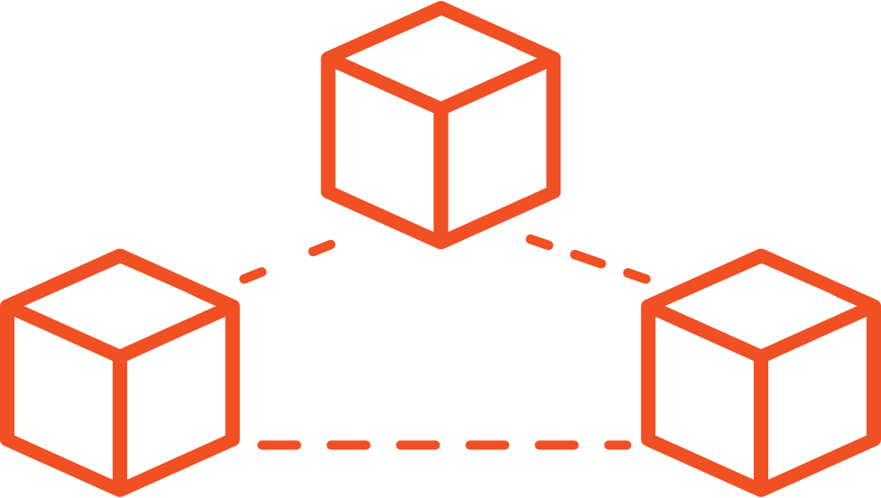
Amar’s doctor uses her cloud-hosted electronic medical records (EMR) solution to retrieve Amar’s demographic record from the national HIE.
She updates the record with Amar’s new phone #.
(5)
EMR
PHR
(7)
(4)
ID#
Amar’s Demographic Record
Primary Care Clinic
(7) Retrieve a demographic record (CR)
(4) Update a demographic record (CR*)
(5) Persist content from CR* -> CR

Slide 67
Query for a Client’s Patient Summary. As part of its normative behaviour, at the beginning of an encounter, a digital health POS will need to be able to query for and ingest/parse a client’s (IPS) patient summary document. The HIE’s FHIR Server, playing the role of a Shared Health Record repository, will need to be able to respond to a POS request by returning a well-formed IPS. This is shown as transaction (8).
HWD
FD
ORG
Interoperability Layer
(16)
(16)
(16)
(16)
OLTP FHIR Server
(2)
TS*
(5)
ILR/TS
ILR-HWR
ILR-FR
ILR-ORG
SHR
HMIS
CR*
CR
(7)
(10)
(11,12,13,14)
(10)
(10)
(10)
(8)
(9)
(9*)
(15)
(7)
ATNA
(8)
(9)
(10)
(11,12,13,14)
(15)
(1)
(3)
(4)
CR*
POS
(6)
POS
Solution
(9)
CCG
Engine
(17)

Slide 68
She retrieve’s Amar’s health summary record from the HIE.
EMR
PHR
(8)
ID#
Amar’s Health Summary
Primary Care Clinic
(8) Retrieve an IPS

Slide 69
Execute Computable Care Guideline (CCG) Processing. Transaction (9) is employed, during an encounter, to launch the processing of one or more CCGs. A POS solution provides a CCG Engine actor with the client’s current IPS using transaction (9) and invokes a $apply operation using transaction (17). Relevant guideline-based care recommendations are returned from the CCG Engine actor and processed by the POS solution. Actions that operationalize the CCG-based recommendations (e.g. measure and record blood pressure, order medications, etc.) are reflected in the client’s real-time IPS. Over the course of the encounter, the transaction 9-17 pattern is repeated until no further recommendations are returned from the CCG Engine.
HWD
FD
ORG
Interoperability Layer
(16)
(16)
(16)
(16)
OLTP FHIR Server
(2)
TS*
(5)
ILR/TS
ILR-HWR
ILR-FR
ILR-ORG
SHR
HMIS
CR*
CR
(7)
(10)
(11,12,13,14)
(10)
(10)
(10)
(8)
(9)
(9*)
(15)
(7)
ATNA
(8)
(9)
(10)
(11,12,13,14)
(15)
(1)
(3)
(4)
CR*
POS
(6)
POS
Solution
(9)
CCG
Engine
(17)

Slide 70
Based on the care guidelines for Amar’s chronic pulmonary disease, the doctor records Amar’s vital signs. His lung capacity reading is concerning.
Care
Guidelines
EMR
PHR
(9)-(17)
Observations:
-BP (slightly elevated)
-Weight (slightly increased)
-Spirometry (worrying!)
Primary Care Clinic
(9) Submit an IPS
(17) “Apply” relevant care guidelines

Slide 71
Per the guidelines, Amar’s doctor changes the prescription for his inhaler. She also orders a Lung Cancer Screening Test for Amar. As has been the case in the past, Amar does not agree to try to stop smoking.
Care
Guidelines
EMR
PHR
(9)-(17)
Orders:
-Inhaler (changed prescription)
-Lung Cancer Screening Test
-Smoking Cessation Programme (not ordered)
Primary Care Clinic
(9) Submit an IPS
(17) “Apply” relevant care guidelines

Slide 72
Submit a Client’s Patient Summary. As part of its normative behaviour, at the end of an encounter, a POS must be able to submit a well-formed IPS to the HIE that includes the details of the encounter including any forward-looking orders or follow-up. The HIE’s FHIR Server, playing the role of a Shared Health Record repository, must ingest/parse the inbound IPS and persist it. This is shown as transaction (9).
HWD
FD
ORG
Interoperability Layer
(16)
(16)
(16)
(16)
OLTP FHIR Server
(2)
TS*
(5)
ILR/TS
ILR-HWR
ILR-FR
ILR-ORG
SHR
HMIS
CR*
CR
(7)
(10)
(11,12,13,14)
(10)
(10)
(10)
(8)
(9)
(9*)
(15)
(7)
ATNA
(8)
(9)
(10)
(11,12,13,14)
(15)
(1)
(3)
(4)
CR*
POS
(6)
POS
Solution
(9)
CCG
Engine
(17)

Slide 73
Amar’s health summary is updated with today’s observations, his ePrescription, and his diagnostic test order. The updated summary is saved to the HIE.
EMR
PHR
(9)
ID#
Amar’s [Updated] Health Summary
Primary Care Clinic
(9) Submit an IPS

Slide 74
HWD
FD
ORG
Query for Interlinked Registry Content. As part of routine processes, a POS may need to query the HIE for information related to facilities, organizations, health workers, available services, and/or the relationships between these. The HIE’s FHIR Server, playing the role of an Interlinked Registry (ILR), will respond to the query and return the relevant content. Such a query against the interlinked registry is shown as transaction (10).
Interoperability Layer
(16)
(16)
(16)
(16)
OLTP FHIR Server
(2)
TS*
(5)
ILR/TS
ILR-HWR
ILR-FR
ILR-ORG
SHR
HMIS
CR*
CR
(7)
(10)
(11,12,13,14)
(10)
(10)
(10)
(8)
(9)
(9*)
(15)
(7)
ATNA
(8)
(9)
(10)
(11,12,13,14)
(15)
(1)
(3)
(4)
CR*
POS
(6)
POS
Solution
(9)
CCG
Engine
(17)

Slide 75
HWD
FD
ORG
Query for Codes. As part of routine processes, a POS may need to lookup a code, validate a code, query for a concept map, or query for a translation from one code system to another. The HIE’s FHIR Server will need to be able to respond to such requests. These are shown as transaction (11), (12), (13) and (14), respectively.
Interoperability Layer
(16)
(16)
(16)
(16)
OLTP FHIR Server
(2)
TS*
(5)
ILR/TS
ILR-HWR
ILR-FR
ILR-ORG
SHR
HMIS
CR*
CR
(7)
(10)
(11,12,13,14)
(10)
(10)
(10)
(8)
(9)
(9*)
(15)
(7)
ATNA
(8)
(9)
(10)
(11,12,13,14)
(15)
(1)
(3)
(4)
CR*
POS
(6)
POS
Solution
(9)
CCG
Engine
(17)

Slide 76
HWD
FD
ORG
Submit Reportable Indicators. There may be MOH mandates for POS solutions to regularly submit reportable indicators (e.g. number of new HIV patients started on antiretroviral medications, number of babies receiving their DPT-3 immunization, etc.). Such a submission, shown as transaction (15), will be directed to the HIE’s Health Management Information System (HMIS). As an alternative, an MOH could opt to leverage a “t-connector” in its data processing pipeline that could de-identify inbound patient summary submissions as part of a separate workflow that does not impede the transaction processing of the HIE’s OLTP-optimized FHIR Server. These de-identified, person-centric data could be persisted to the HMIS to support advanced analyses not possible with aggregated data, alone. Such a pipeline, which could operate either in near real time or as a batch, is shown as transaction (9*).
Interoperability Layer
(16)
(16)
(16)
(16)
OLTP FHIR Server
(2)
TS*
(5)
ILR/TS
ILR-HWR
ILR-FR
ILR-ORG
SHR
HMIS
CR*
CR
(7)
(10)
(11,12,13,14)
(10)
(10)
(10)
(8)
(9)
(9*)
(15)
(7)
ATNA
(8)
(9)
(10)
(11,12,13,14)
(15)
(1)
(3)
(4)
CR*
POS
(6)
POS
Solution
(9)
CCG
Engine
(17)

Slide 77




Aggregated
Person-centric Data
Health Management Information System
Web Form
Shared Health Record Repository
EMR
Person-centric
Data
Batch-aggregated
Person-centric Data
100%
EMR
HMIS
Traffic
Automatically De-identified
Person-centric Data
0%
Time
Notes:
Use this slide to edit the graphic

Slide 78
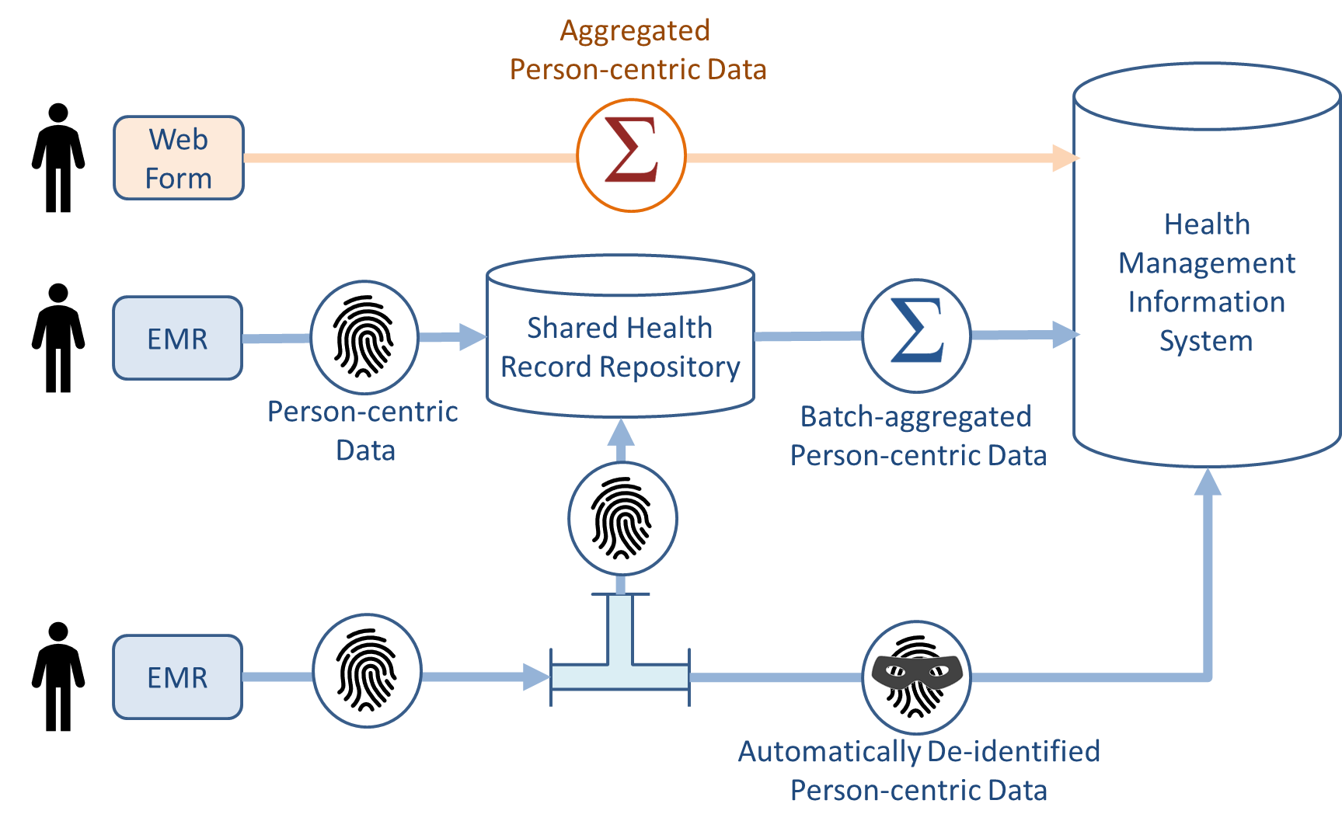
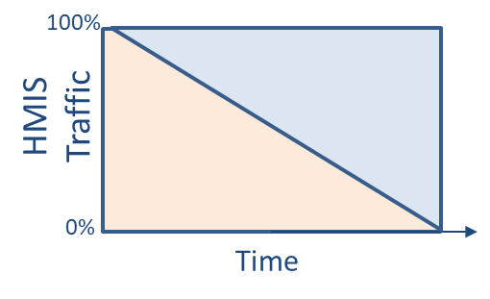
Over time, more and more of the traffic into the HMIS will evolve to become batch-aggregated (from the SHR) or de-identified person-centric data.

Slide 79
Refresh and Update Interlinked Registries. The HIE FHIR Server’s data regarding facilities, organizations, and health workers will need to be regularly refreshed and the cross-referencing between these data will need to be governed and managed. The sources of these data are expected to be a federation of underlying health worker directories (HWD), facility directories (FD) and organization (ORG) directories. Some HMIS solutions, such as DHIS2 as an example, can also play the role of a facility directory or an organization directory. The refresh transaction is shown as transaction (16).
HWD
FD
ORG
Interoperability Layer
(16)
(16)
(16)
(16)
OLTP FHIR Server
(2)
TS*
(5)
ILR/TS
ILR-HWR
ILR-FR
ILR-ORG
SHR
HMIS
CR*
CR
(7)
(10)
(11,12,13,14)
(10)
(10)
(10)
(8)
(9)
(9*)
(15)
(7)
ATNA
(8)
(9)
(10)
(11,12,13,14)
(15)
(1)
(3)
(4)
CR*
POS
(6)
POS
Solution
(9)
CCG
Engine
(17)

Slide 80
HWD
FD
ORG
Privacy, Security, and Auditing. The Interoperability Layer is used to manage the HIE’s transactional traffic. This includes enforcing key mandates related to authentication, authorization, privacy / consent, consistent time, and auditing. These are pervasive requirements that apply to all traffic that traverses the HIE.
Interoperability Layer
(16)
(16)
(16)
(16)
OLTP FHIR Server
(2)
TS*
(5)
ILR/TS
ILR-HWR
ILR-FR
ILR-ORG
SHR
HMIS
CR*
CR
(7)
(10)
(11,12,13,14)
(10)
(10)
(10)
(8)
(9)
(9*)
(15)
(7)
ATNA
(8)
(9)
(10)
(11,12,13,14)
(15)
(1)
(3)
(4)
CR*
POS
(6)
POS
Solution
(9)
CCG
Engine
(17)

Slide 81
LEVERAGING LEGACY SOLUTIONS
There may be architectural elements have been deployed and taken to scale.
Where practical, these legacy solutions will be incorporated into the HIE. This will be accomplished by developing a standards-conformant wrapper (a façade) for the existing solution.
The façade will be used to add a communications interface to the legacy solution that adheres to the HIE’s normative transaction processing specifications.
Loose coupling will be favoured; this will best defend OLTP performance of the HIE’s FHIR Server.

Slide 82

Legacy
Software
Solution
Standards-based Interface
Proprietary
Interface
The software façade ingests the legacy software solution’s proprietary interface, applies mapping and translation routines, and exposes the transformed messages via a standards-based interface. A façade can be constructed to operate as a 1-way or as a 2-way communications interface.

Slide 83

Examples: Legacy Solutions
with FHIR-conformant wrappers
ORG
Interoperability Layer
(16)
(16)
(16)
(16)
OLTP FHIR Server
(2)
(9)
TS*
(5)
ILR/TS
ILR-HWR
ILR-FR
ILR-ORG
SHR
HMIS
CR*
CR
(7)
(10)
(11,12,13,14)
(10)
(10)
(10)
(8)
(9)
(9*)
(15)
(7)
ATNA
(8)
(9)
(10)
(11,12,13,14)
(15)
(1)
(Maintenance/batch transactions)
(Real-time runtime transactions)
CR*
POS
(6)
POS
Solution
(9)
CCG
Engine
(17)

Slide 84
One of the advantages of adopting standards is that there are many credible product options to choose from.
OLTP FHIR Server
Terminology Server
Interoperability Layer
Health Management Information System
TS*
Client Registry
HMIS
CR*
Interoperability Layer
ATNA
CR*
POS
POS
Solution
CCG
Engine
Point-of-Service Solutions

Slide 85



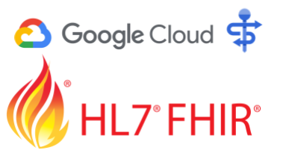



One of the advantages of adopting standards is that there are many credible product options to choose from.
https://hapifhir.io/
https://linuxforhealth.github.io/FHIR/
https://cloud.google.com/healthcare-api?hl=en
https://github.com/microsoft/fhir-server
and many others…
https://www.health-samurai.io/aidbox
https://www.smiledigitalhealth.com/
https://kodjin.com/
OLTP Server options

Slide 86







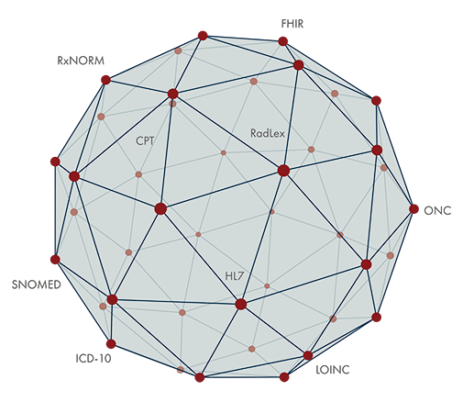

One of the advantages of adopting standards is that there are many credible product options to choose from.
https://openhim.org/
https://ontoserver.csiro.au/site/
https://www.santesuite.com/#products
https://wso2.com/integration/
Interoperability Layers
https://openconceptlab.org/
https://github.com/jembi/JeMPI
https://dhis2.org/
https://apelon.com/
https://www.openclientregistry.org/
https://docs.aidbox.app/storage-1/sql-on-fhir
Terminology Servers
Client Registries
HMIS

Slide 87







One of the advantages of adopting standards is that there are many credible product options to choose from.
https://santesuite.com/index.html#
https://openmrs.org/
https://opensrp.io/
https://fammed.mcmaster.ca/oscar-emr/
and many others…
https://www.bahmni.org/
https://worldvista.org/
https://openelis-global.org/
Point of Service Options

Slide 88
KEY TAKEAWAY POINTS
An OpenHIE-on-FHIR infrastructure can be assembled out of a relatively small number of conformance-testable digital health Lego® blocks.
The technical configuration must defend online transaction processing (OLTP) performance.
A T-junction design supports important opportunities to leverage health transactions to drive analytics and companion processing (e.g. supply chain, finance, etc.).
Legacy solutions may be incorporated into the standards-based infrastructure via a software façade.
There are multiple conformant open-source and commercial options for the various HIE components.

Slide 89

Questions and Answers?

Slide 90
INTERACTION 2.2
<paste Form link here>
Is there a consensus position within the MOH regarding the benefits versus risks of adopting a cloud-hosted architecture?
Are there examples, today, of government departments leveraging cloud-hosted services?
Are there examples, today, of employing a façade pattern to add standards-based interfaces to a proprietary software solution?

Slide 91

How can we capture “health value” from our digital health investments?

Slide 92
Computable Care Guidelines (CCGs) can help us maximize the care delivered in the GREEN ZONE.
Errors of
Omission
Everything that was done during a care encounter
The GREEN ZONE
Everything that should be done during a care encounter
Errors of Commission

Slide 93
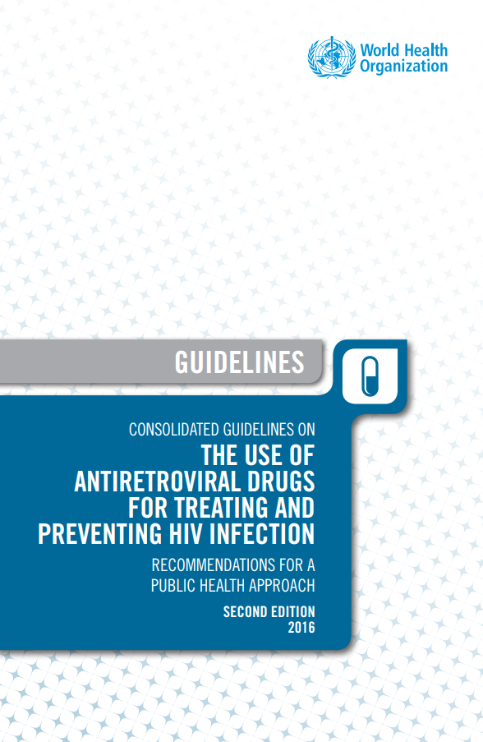

Using HIV as an example, the HL7 FHIR standard can be employed to express an evidence-based care pathway in a CCG format that a software solution can ingest and “run”.
Everything that should be done during a care encounter
Care Guidelines
for HIV
Computable Care Guidelines
for HIV

Slide 94


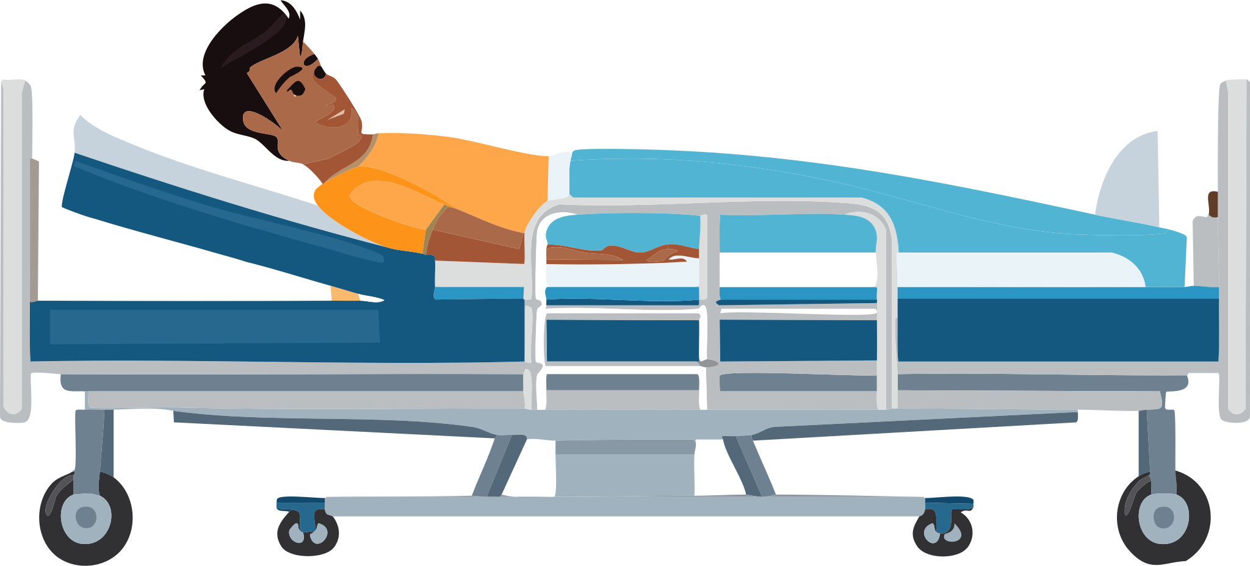
Digital health solutions that “understand” the CCG will systemically operationalize evidence-based HIV care across the whole of the care delivery network.
Everything that should be done during a care encounter
Computable Care Guidelines
for HIV

Slide 95


CCGs normatively define the minimum data set (MDS) needed to drive the guideline-based care and the care logic and reportable indicators that the MDS supports.
MDS
Care logic
Indicators
Everything that should be done during a care encounter
Computable Care Guidelines
for HIV

Slide 96
CCGs normatively define the minimum data set (MDS) needed to drive the guideline-based care and the care logic and reportable indicators that the MDS supports.
HIV / ANC / Immunization / etc…
Everything that should be done during a care encounter
Computable Care Guidelines
for HIV

Slide 97

What mandatory digital health “behaviours” are needed to ensure we can capture this health value?

Slide 98
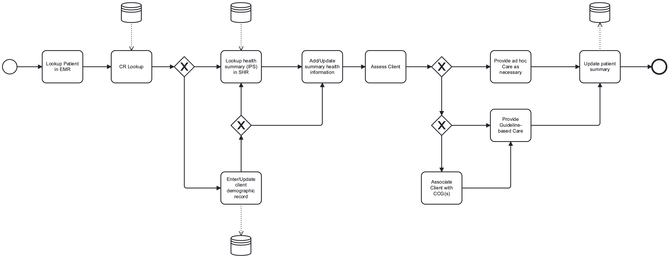
HIE
HIE
HIE
ITI-65
Encounter
IPS
7
ITI-78
8
ITI-67
ITI-68, IPS
9
Ad hoc
encounter
Encounter
Start
Encounter
End
Patient ID not found
or edits needed
existing ID
edited
New ID
created
Guideline-based
encounter
9
17
CCG Available
3
4
ITI-93
HIE
Use this slide to edit the PNG graphic, if needed.

Slide 99
ITI-65
Encounter
IPS
HIE
HIE
HIE
7
ITI-78
8
ITI-67
ITI-68, IPS
9
Ad hoc
encounter
Encounter
Start
Encounter
End
Patient ID not found
or edits needed
existing ID
edited
New ID
created
Guideline-based
encounter
9
17
CCG Available
3
4
ITI-93
HIE
Use this slide to edit the PNG graphic, if needed.

Slide 100
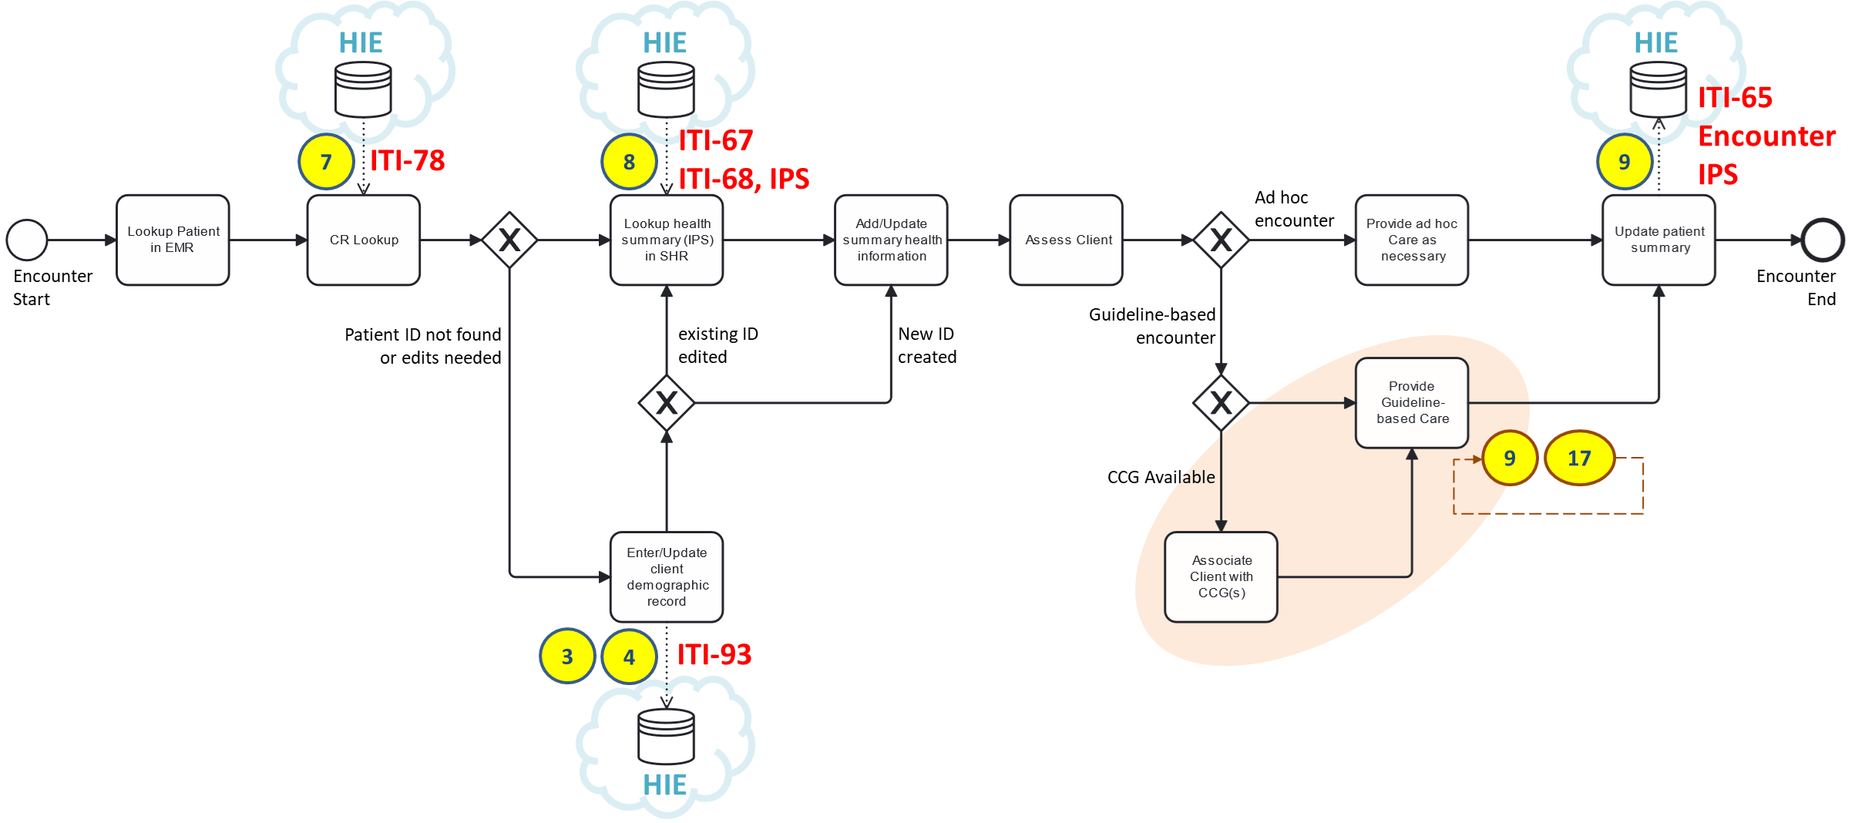
Referencing our HIE transaction numbers, we can normatively define what are the necessary behaviours of a POS solution.

Slide 101
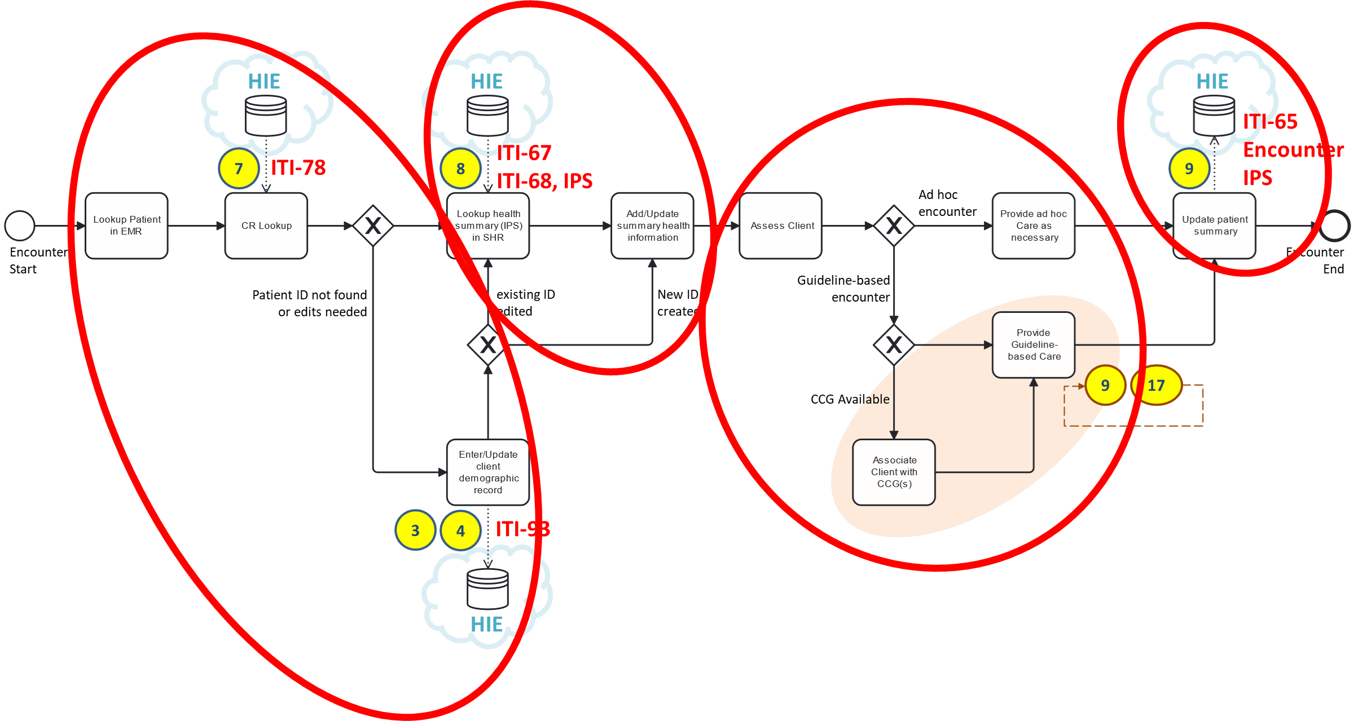

These mandatory POS behaviours can be thought of as a simple 1-2-3-4 pattern (like in a dance).
Unambiguously identify the subject of care.
Retrieve the subject’s health summary.
Update the subject’s health summary
Based on the summary, and on the current situation, provide appropriate care.

Slide 102



This pattern repeats.
At every care encounter…
Identify the person
Retrieve their health story (“IPS”)
Provide care
Update their IPS
1-2-3-4
1-2-3-4
1-2-3-4
VCCT clinic
Immunization clinic
District clinic

Slide 103
Operationalizing the Care Pattern
with Digital Health Transactions
QUERY for the client against the MPI.
If found, confirm demographic details.
If edits needed, UPDATE details in the MPI.
If not found, ADD the client to the MPI.
SYNC local system to MPI’s demographic data.
POST the client’s IPS to the shared health record.*
QUERY for the client’s IPS from the SHR.
Assess the client; triage if necessary.
Leverage the CarePlan (from the IPS).
Perhaps leverage one ore more CCGs (if applicable).
Locally, SAVE the results of the care encounter plus any orders (e.g. medications, lab tests, procedures, etc.).
If necessary, escalate care; create referrals to another provider, or another facility.
Indicate necessary follow-up visits, if applicable.
From the local system, POST the updated IPS to the SHR.
*Merging data from multiple sources into a single patient record can be complicated. The POST-then-QUERY pattern will allow the merging logic to be centrally hosted at the SHR… and this simplifies processing for point of care applications (EMRs, pharmacy systems, lab systems, mHealth apps, etc.)

Slide 104
KEY TAKEAWAY POINTS
The repeated 1-2-3-4 pattern, with CCGs, can systemically improve guideline-adherence. Improved adherence will improve health outcomes.
Data collected during each CCG-enabled encounter will be “good” data.
These data will support analytics that can serve health system management, including supporting performance-based financing.
Large data sets of “good”, de-identified, person-centric data can be leveraged to support AI-based analyses.

Slide 105

Questions and Answers?

Slide 106
INTERACTION 2.3
<paste Form link here>
Are there national care guidelines for the top-10 burden of disease conditions identified by IHME? [list of burden of disease]
What are the implications of a CCG-based approach that favours digital health platform solutions rather than a proliferation of siloed, sole-purpose apps?
What are the potential impacts of a CCG approach on our ability to leverage innovative big data analytics, including AI-based techniques.

Slide 107

How does digital health impact upon health?

Slide 108
Health Interventions
Population
Health
Yield

Slide 109
Operationalizes
Health Interventions
Digital Health Infrastructure
Population
Health
Yield

Slide 110
Operationalizes
Health Interventions
Digital Health Infrastructure
Population
Health
Person-centric
transactional data
Generate
Yield

Slide 111

Operationalizes
Population-level
health metrics
Health Interventions
Digital Health Infrastructure
Population
Health
Person-centric
transactional data
Generate
Yield

Slide 112
Operationalizes
Inform
Population-level
health metrics
Health Interventions
Digital Health Infrastructure
Population
Health
Person-centric
transactional data
Generate
Yield

Slide 113

What are the implications for AI?

Slide 114
What if some “non-indicated” care activities systemically yield better health outcomes?
What if omitting some “indicated” care activities statistically yields identical (or even better) health outcomes?
The GREEN ZONE

Slide 115
KEY TAKEAWAY POINTS
We can use digital health to both meter the health system – and to exert process control upon it.
Digital health can play an industrial engineering role. It can be leveraged to improve consistency in execution of the “health production function”.
We should leverage digital health in support of care workflows. Atomic, person-centric data serves both person-centric care and population-level monitoring.
Analytics can be leveraged to inform improvements to the health system operations, and/or to the digital health supported interventions. This feedback loop creates a Learning Health System.

Slide 116

Questions and Answers?

Slide 117
NEXT STEPS…WORKSHOP 3
Conduct a landscape analysis of existing digital health solutions
Map solutions to the actors (building blocks) in our digital health infrastructure design
Evaluate degrees of standards-readiness
Look for “quick win” opportunities to leverage existing solutions to accelerate the HIE deployment
REMEMBER
You will need your PC, tablet, or smartphone
to fill in the questionnaires.

